Slide 1
Weekly Webinar
Welcome to the Wednesday webinar!
Please mute your audio connection upon logging in.
For the first 10-15 mins we will discuss the topic at hand.
Once we go through the presentation, we will open up for questions on what we just discussed.
After there are no more questions, we will open questioning for ANY Digital resource subject.
Please raise your hand in the taskbar or type your question in the questions box.
Chad Jordan and John Musser
SCI Digital Marketing website.request@sportclips.com

Slide 2
Webinar Instructions
Please make sure to mute your audio connection.
Submit questions through control panel.

Slide 3
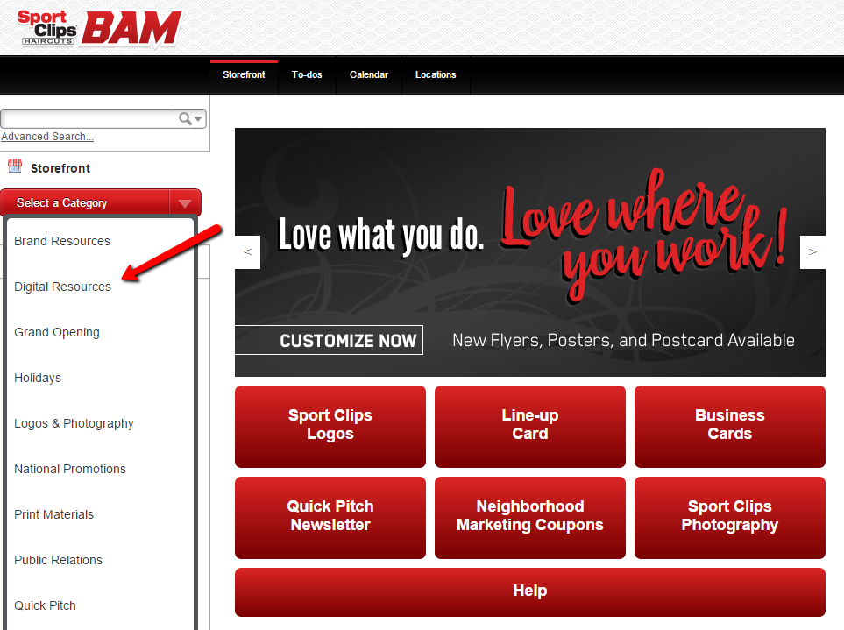
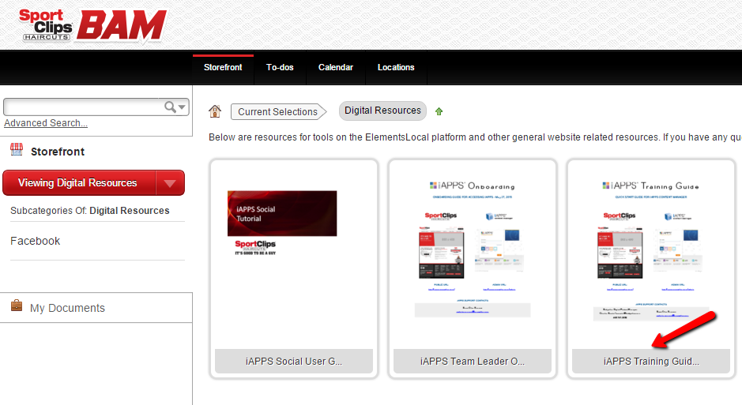
iAPPS Training Guide
STEP #1
STEP #2

Slide 4
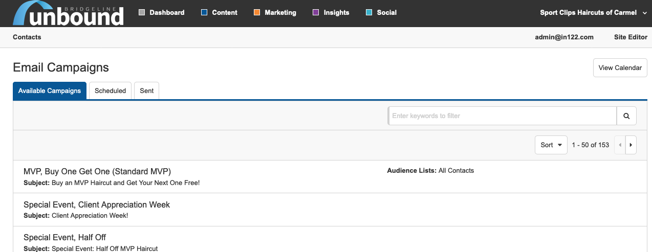
Unbound Email Marketing: Multiple Options
We now have over 100 Email Campaigns that TL’s can use to reach clients

Slide 5
Request Artwork
You will FIRST need to request that artwork be created at: https://scicreative.supportsystem.com/open.php
You will want to provide a 2-3 week lead time for artwork to be created and returned.

Slide 6
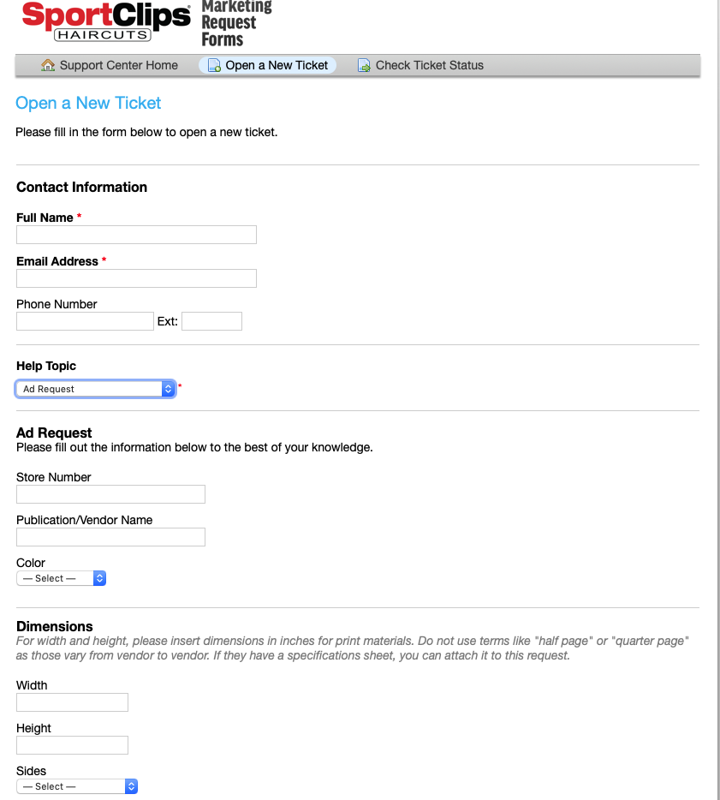
Fill Out Form
Complete the form with your information and put “Ad Request” at the Help Topic.
For size specs, please put 8.33 for Width and 12.78 for Height.

Slide 7
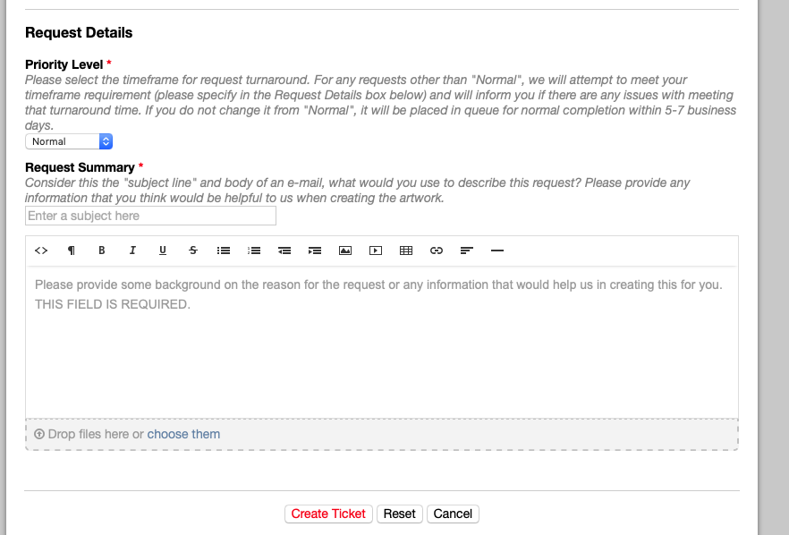
Create Ticket
Before clicking “Create Ticket”, complete the “Request Details” as thoroughly as possible.

Slide 8
Receiving Artwork
Once you receive the artwork from our Creative Department, please review for accuracy and save the image to your computer.

Slide 9
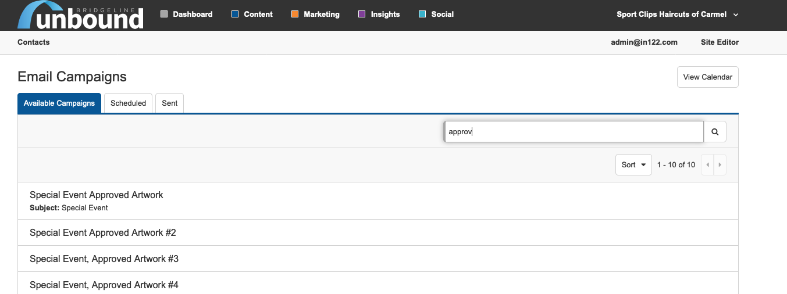
Finding the Approved Artwork Campaign
Search for “Approved Artwork” in the search window of “Available Campaigns” and click the email (Does not matter which “#” you use)

Slide 10
Selecting Approved Artwork Campaign
Click “Edit & Schedule”

Slide 11
Accessing the Email Subject Line
First, you will want to change the email subject line. Click the drop down arrow in “Email Actions” to expand the selection and select “View/Edit Details”.

Slide 12
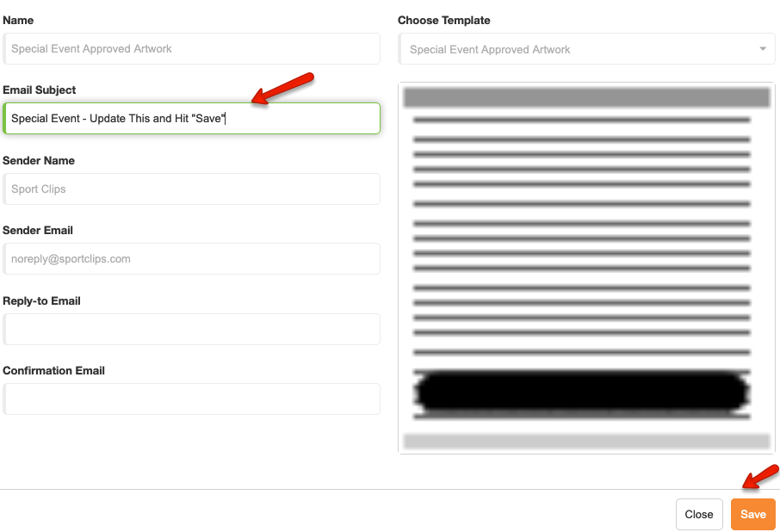
Changing the Email Subject Line
Type in the new Email Subject describing your email / event
Click “Save”

Slide 13
Adding the Approved Artwork
Click the pencil icon to access image editor.
Next, select “Create New Text”

Slide 14
Editor Appears
The editor will now appear. Click the picture icon to upload your Approved Artwork.

Slide 15
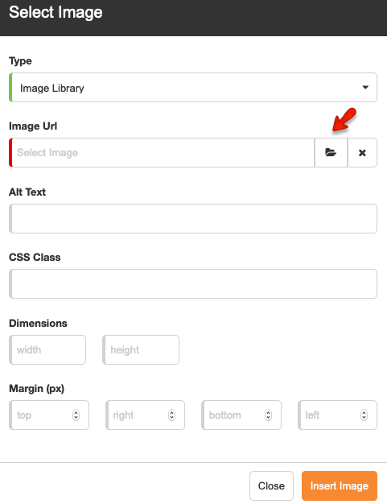
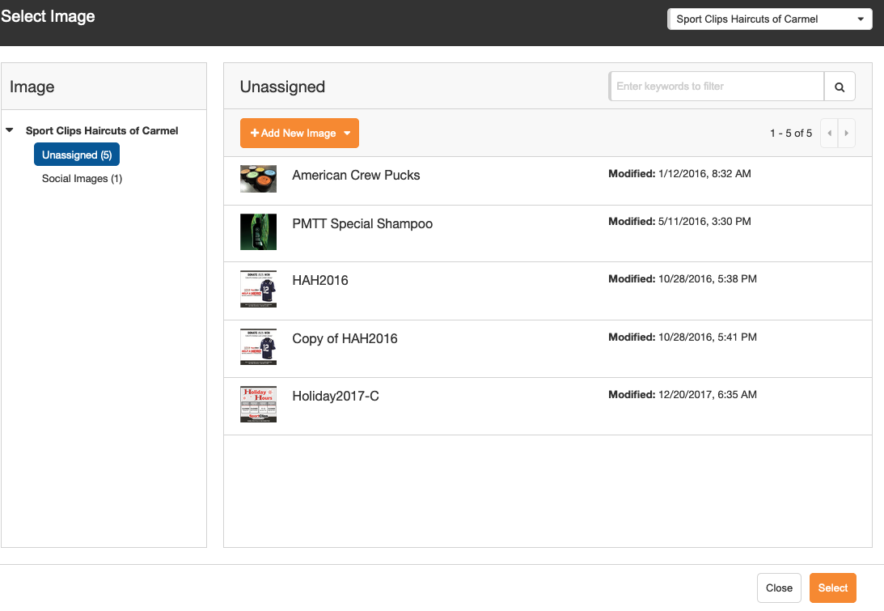
Uploading the Approved Artwork
1. In the Image URL field, click the Folder icon.
2. Click “Add New Image” and follow prompts.

Slide 16
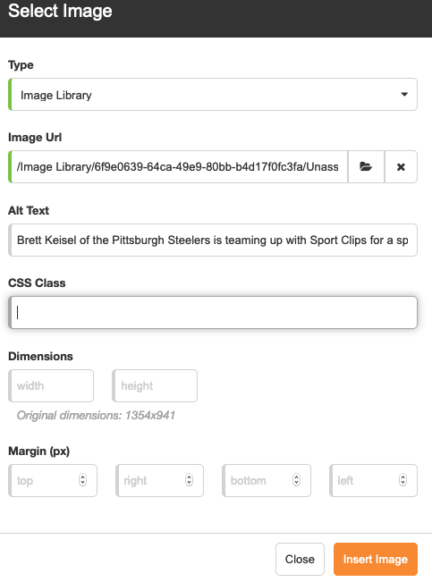
Adding “Alt Text”
Before you click “Insert Image”, please remember to add “Alt Text” for ADA compliance purposes. This alt text should simply be a description of the image you are inserting.

Slide 17
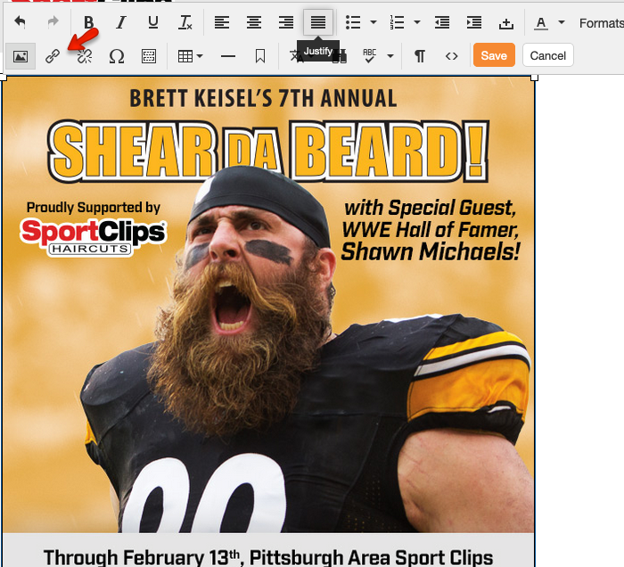
Adding a Link to the Approved Artwork Campaign
To add a hyperlink, click on the image and then click the chain link icon in the editor.

Slide 18
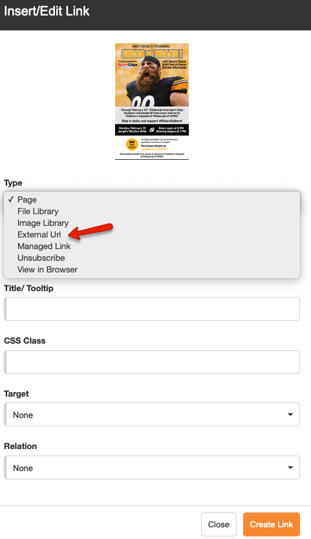
Adding a Link to the Approved Artwork Campaign (cont’d)
In the pop-up window, select “External URL” in the Type field

Slide 19
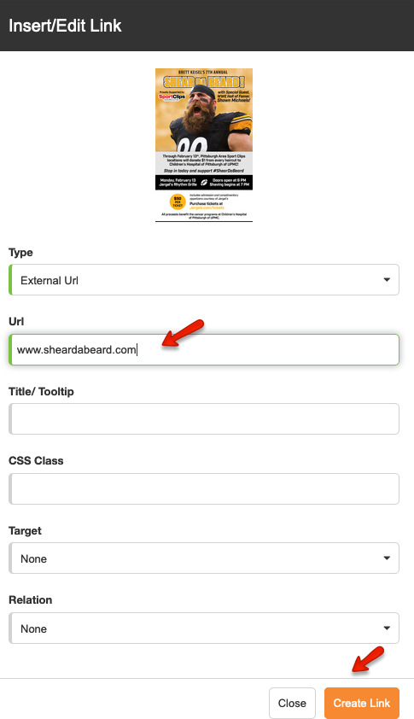
Adding a Link to the Approved Artwork Campaign (cont’d)
In the pop-up window, type in the web address you want to point to in the URL field and click “Create Link”

Slide 20
Saving the Approved Artwork Email
Click the “Save” button in the editor.

Slide 21
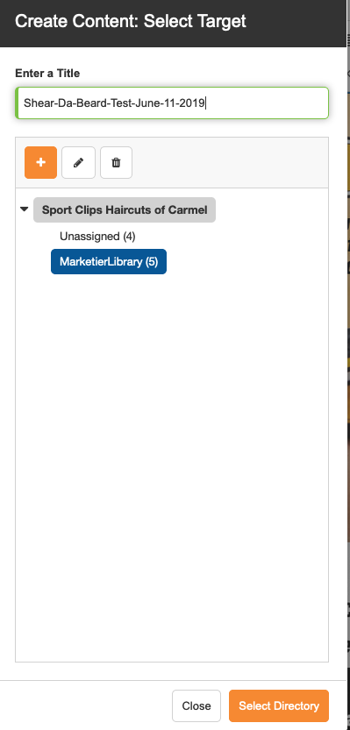
Saving the Approved Artwork Email (cont’d)
Select the “MarketierLibrary” folder and name the email content in the “Enter a Title” field. Lastly, click “Select Directory”. This will save your CONTENT, but not the entire email. One step remains.

Slide 22
Saving the Approved Artwork Email
Once you are satisfied with your email, click the “Save” button in the upper right hand corner. Now proceed with sending a test email and scheduling your campaign for delivery.

Slide 23
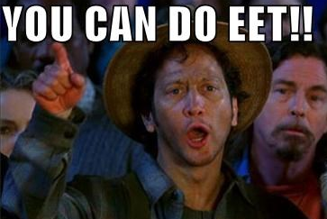
Digital Marketing
iAPPS Log-In – www.sportclips.com/admin
“Survey Says!” – www.sportclips.com/leadership
Chad Jordan, website.request@sportclips.com

